Slide 1

Digital Image Processing
National University of Sciences and Technology (NUST)
School of Electrical Engineering and Computer Science (SEECS)

Slide 2
Intensity Transformations
Look-up Tables
Linear Contrast Stretch
Piece-wise Contrast Stretch
Histogram Equalization
Power Law
Log Transform – Gamma correction

Slide 3

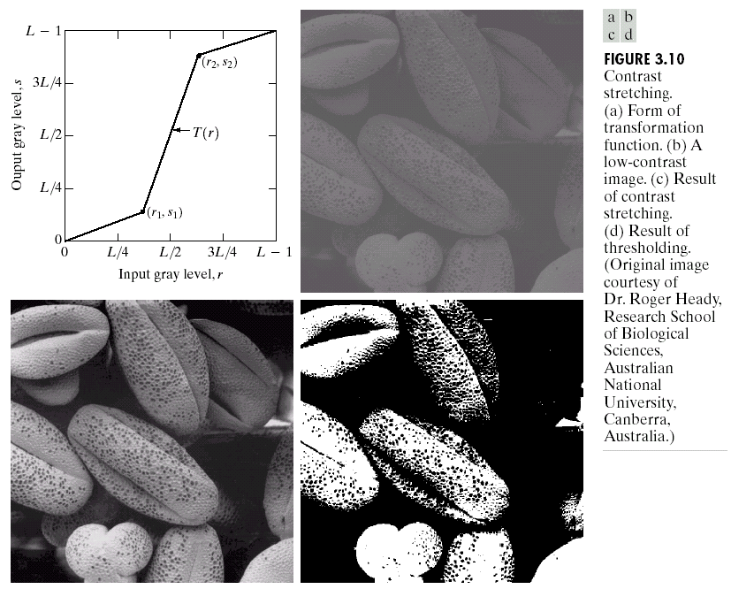
Dynamic Range vs Contrast
Dynamic Range
Minimum Possible Intensity to Maximum Possible Intensity
Contrast
Minimum Image Intensity to Maximum Image Intensity
Notes:
The contents of my presentation are ...

Slide 4
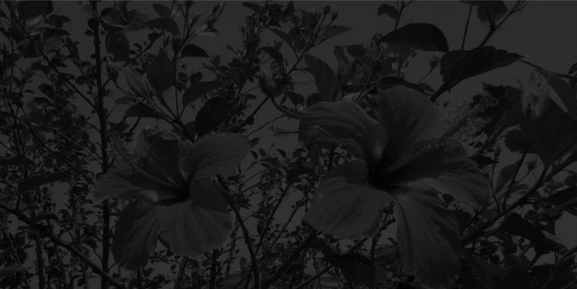
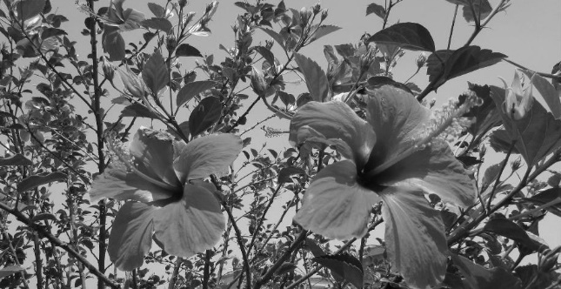
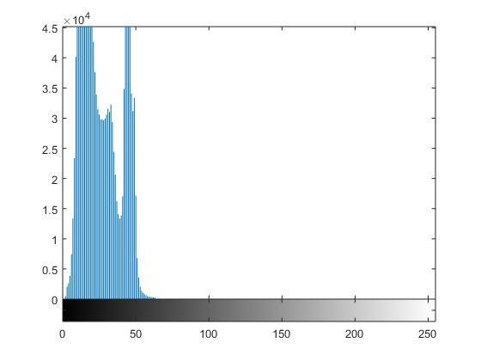
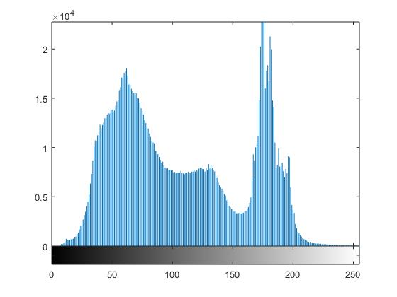
Dynamic Range vs Contrast
Introduction
Dynamic range (8-bit) = $max −min=255−0=255$
Contrast = 0 - 55
Contrast = 0 - 255

Slide 5
Dynamic Range vs Contrast
Introduction
Introduction
X
Y
Dynamic Range
Contrast
255
0-255
255
50-255
255
75-255
255
100-255

Slide 6
Intensity Transformations
Point/Pixel operations
Output value at specific coordinates (x,y) is dependent only on the input value at (x,y)
Local operations
The output value at (x,y) is dependent on the input values in the neighborhood of (x,y)
Global operations
The output value at (x,y) is dependent on all the values in the input image
Notes:
6

Slide 7
Intensity Transformations
Basic Concept
Most spatial domain enhancement operations can be generalized as:
f (x, y) = Input image
g (x, y) = Processed/output image
T = Operator defined over some neighbourhood of (x, y)
Notes:
7

Slide 8
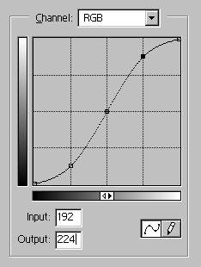
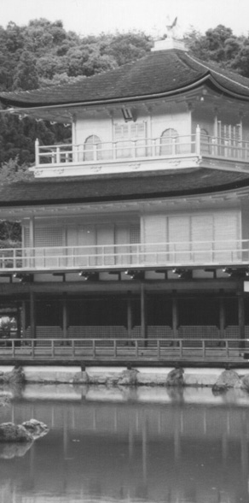
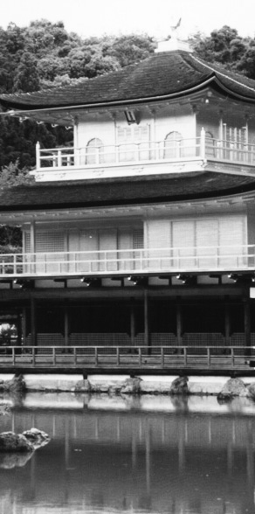
Point Processing using Look-up Tables
Look up Table Mapping
input
output
.
.
.
.
.
.
.
.
a pixel with this value
.
.
is mapped to this value
.
.
cell index
contents
.
.
.
.
.
.
.
.
.
.
.
.
Notes:
8

Slide 9
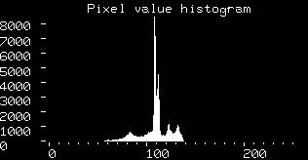

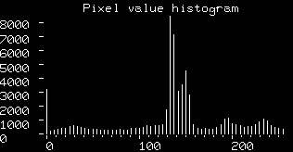
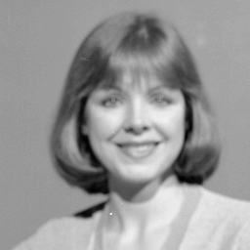
Linear Contrast Stretch

Slide 10
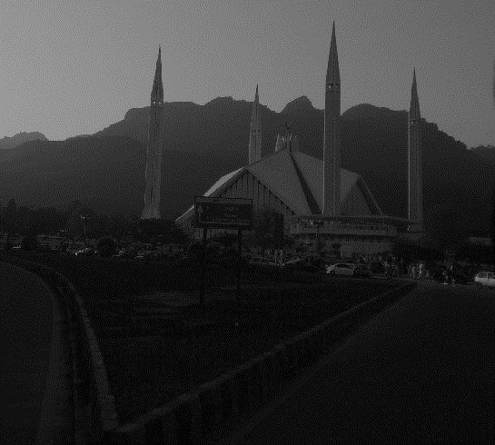
Linear Contrast Stretch
Linear Contrast Stretching
Original Image

Slide 11
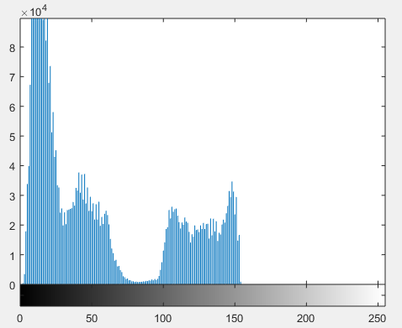
Linear Contrast Stretch
Linear Contrast Stretching
Original Image
Histogram

Slide 12
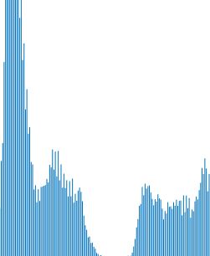
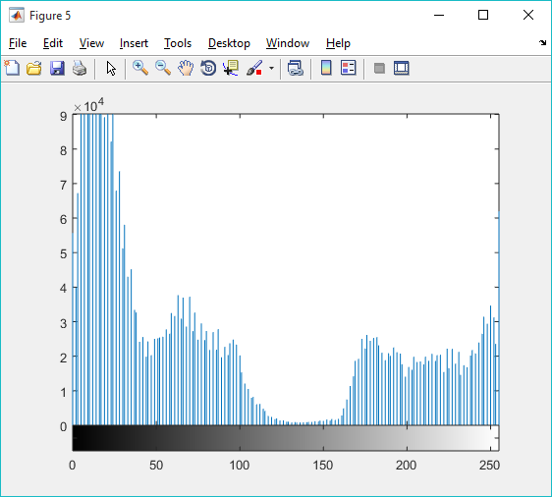
Linear Contrast Stretch
Linear Contrast Stretching
Original Image
Histogram
Linear Contrast Stretching

Slide 13

Linear Contrast Stretch
Linear Contrast Stretching
Original Image
Linear Contrast Stretching
Output Image

Slide 14
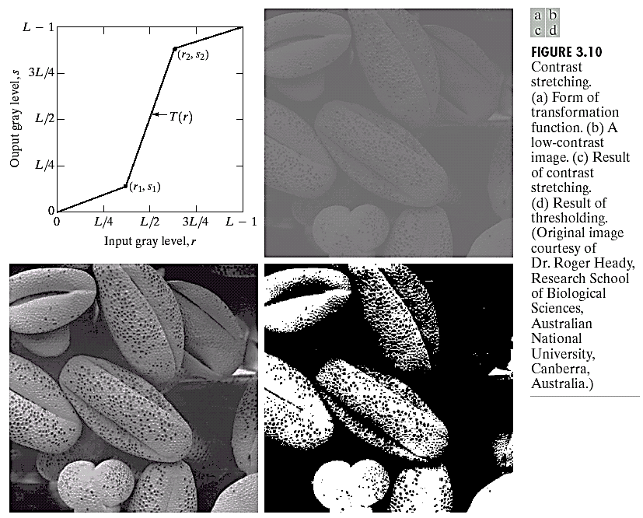
Piece-wise Contrast Stretching
Objective
Increase the dynamic range of the gray levels for low contrast images
Rather than using a well defined mathematical function we can use arbitrary user-defined transforms
If r₁ = s₁ & r₂ = s₂, no change in gray levels
If r₁ = r₂, s₁ = 0 & s₂ = L-1, then it is a threshold function. The resulting image is binary
Notes:
14

Slide 15
Piece-wise Contrast Stretching
Notes:
15

Slide 16
Intensity Level slicing
This technique is used to highlight a specific range of gray levels in a given image.
Similar to thresholding – Other levels can be suppressed or maintained – Useful for highlighting features in an image .
It can be implemented in several ways, but the two basic themes are: One approach is to display a high value for all gray levels in the range of interest and a low value for all other gray levels.
The second approach, based on the transformation brightens the desired range of gray levels but preserves gray levels unchanged.

Slide 17
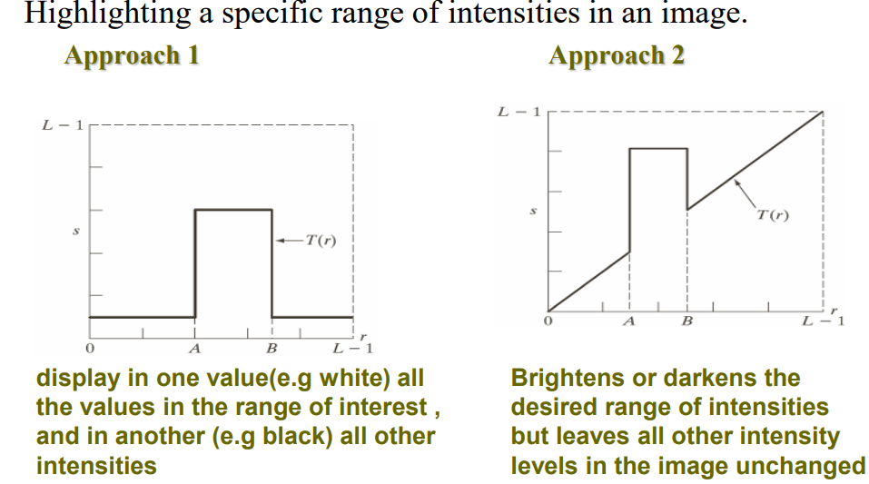
Intensity level slicing

Slide 18
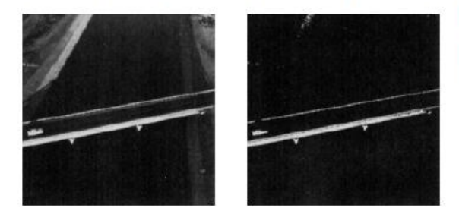
Intensity level slicing

Slide 19
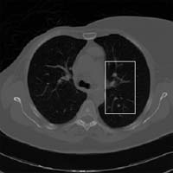
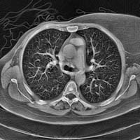
Intensity level slicing
Intensity values corresponding to the Lungs is enhanced.

Slide 20
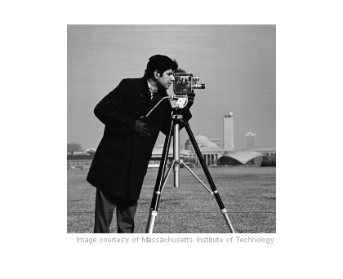
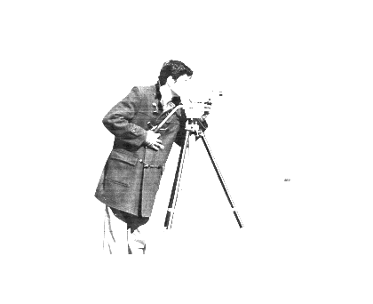
Window Level
Window of dark intensity values are enhanced.

Slide 21
Image Histogram
The histogram of a digital image with gray values is the discrete function
n_{k} : Number of pixels with gray value r_{k}
n : Total number of pixels in the image
The function p(r_{k}) represents the fraction of the total number of pixels with gray value r_{k}.

Slide 22
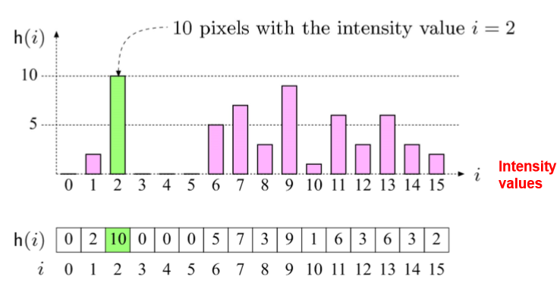
Image Histogram
The histogram of an image shows us the distribution of grey levels in the image

Slide 23
Image Histogram
The (intensity or brightness) histogram shows how many
times a particular grey level (intensity) appears in an image.
For example, 0 - black, 7 – white 3 Bits gray image
0 | 1 | 1 | 2 | 4
2 | 1 | 0 | 0 | 2
5 | 2 | 0 | 0 | 4
1 | 1 | 2 | 4 | 1
Image

Slide 24
Image Histogram
The (intensity or brightness) histogram shows how many
times a particular grey level (intensity) appears in an image.
For example, 0 - black, 7 – white (3 bits)
0 | 1 | 1 | 2 | 4
2 | 1 | 0 | 0 | 2
5 | 2 | 0 | 0 | 4
1 | 1 | 2 | 4 | 1
Image
Histogram

Slide 25
Histogram Calculation
I = imread('rain.jpg');
G = rgb2gray(I);
[x,y] = size(G);
H = zeros(1,8);
for i=1:x
for j=1:y
H(G(i,j)) = H(G(i,j)) + 1;
end
end
stem(H);

Slide 26
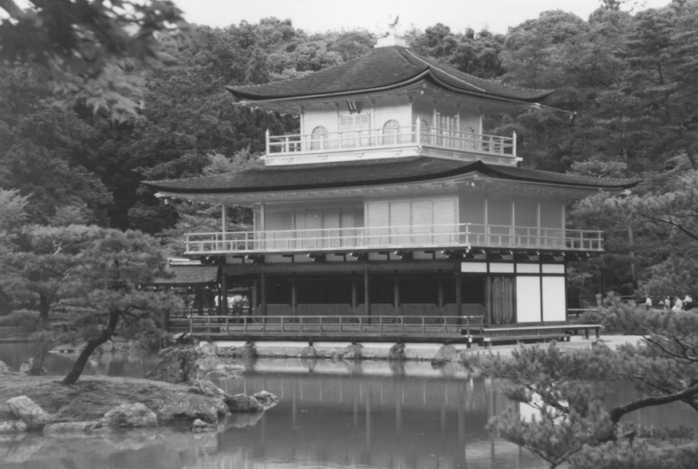
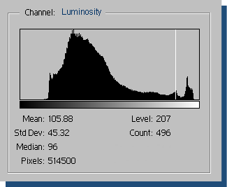
Histogram – Gray Scale Image
Notes:
26

Slide 27
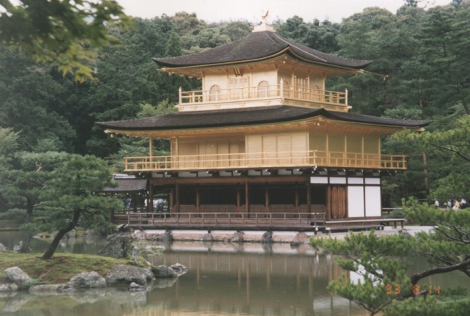
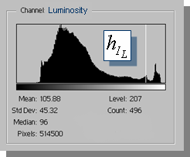
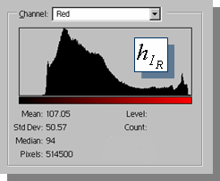
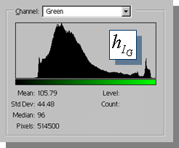
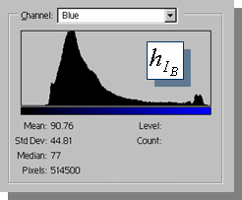
Histogram – Color Image
There is one histo-gram per color band
R, G, & B. Gray histogram is from 1 band = (R+G+B)/3
Notes:
27

Slide 28
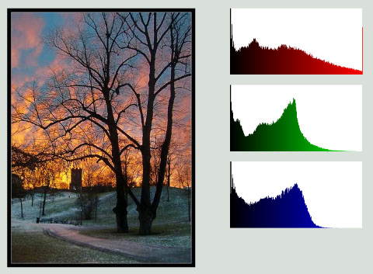
Histogram – Color Image
Notes:
28

Slide 29
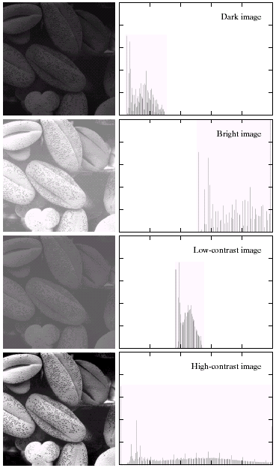
Histogram – Example
A selection of images and their histograms
Notice the relationships between the images and their histograms
Note that the high contrast image has the most evenly spaced histogram
Notes:
29

Slide 30
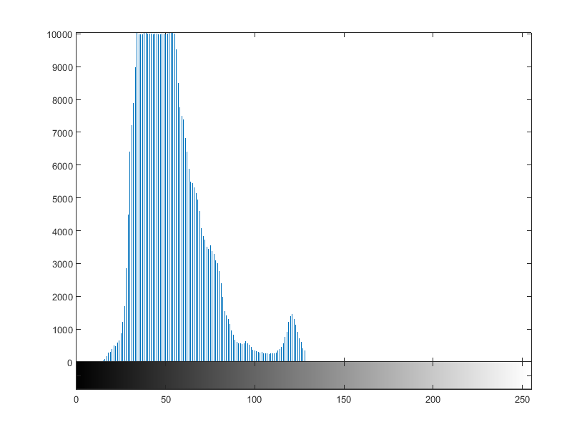
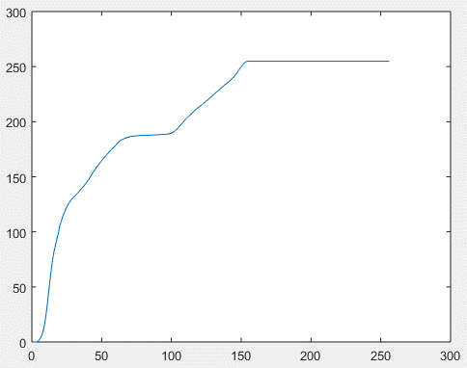
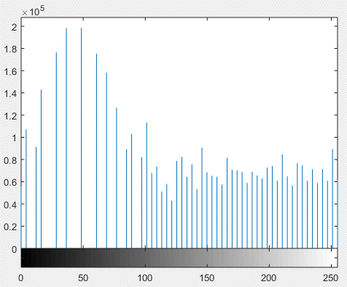
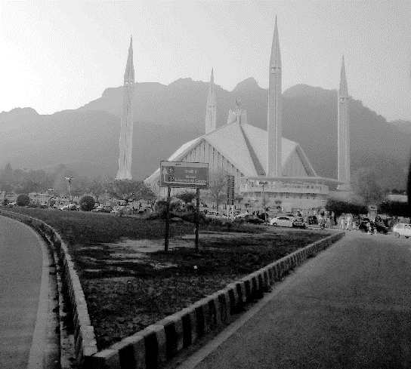
Histogram Equalization
Histogram
CDF
Equalized histogram
Original Image
Output Image

Slide 31
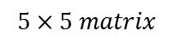
Histogram to CDF
0 | 0 | 0 | 2 | 2
1 | 1 | 1 | 2 | 2
5 | 5 | 5 | 3 | 3
5 | 6 | 6 | 4 | 3
4 | 4 | 4 | 4 | 4
$$5×5 matrix$$

Slide 32
Histogram to CDF
0 | 0 | 0 | 2 | 2
1 | 1 | 1 | 2 | 2
5 | 5 | 5 | 3 | 3
5 | 6 | 6 | 4 | 3
4 | 4 | 4 | 4 | 4
0 | 0 | 0 | 2 | 2
1 | 1 | 1 | 2 | 2
5 | 5 | 5 | 3 | 3
5 | 6 | 6 | 4 | 3
4 | 4 | 4 | 4 | 4
$$5×5 matrix$$
$$5×5 matrix$$

Slide 33
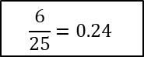
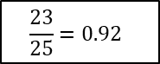
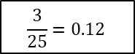
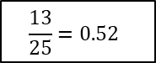
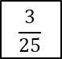
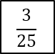
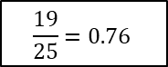
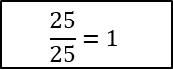
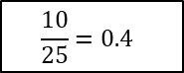
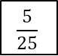
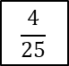
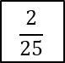
Histogram to CDF
Pixel
No. of pixel
PDF
CDF
3
$$\frac{3}{25}$$
$$\frac{3}{25}=0.12$$
3
$$\frac{3}{25}$$
$$\frac{6}{25}=0.24$$
0 | 0 | 0 | 2 | 2
1 | 1 | 1 | 2 | 2
5 | 5 | 5 | 3 | 3
5 | 6 | 6 | 4 | 3
4 | 4 | 4 | 4 | 4
0 | 0 | 0 | 2 | 2
1 | 1 | 1 | 2 | 2
5 | 5 | 5 | 3 | 3
5 | 6 | 6 | 4 | 3
4 | 4 | 4 | 4 | 4
4
$$\frac{4}{25}$$
$$\frac{10}{25}=0.4$$
3
$$\frac{3}{25}$$
$$\frac{13}{25}=0.52$$
6
$$\frac{5}{25}$$
$$\frac{19}{25}=0.76$$
$$5×5 matrix$$
$$5×5 matrix$$
4
$$\frac{4}{25}$$
$$\frac{23}{25}=0.92$$
2
$$\frac{2}{25}$$
$$\frac{25}{25}=1$$

Slide 34
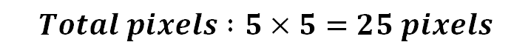
Histogram to CDF
$$Total pixels :5×5=25 pixels$$
Number of pixels | Probability | CDF
1 | 1/25 = 0.04 | 0.04
2 | 2/25 = 0.08 | 0.12
8 | 8/25 = 0.32 | 0.44
10 | 10/25 = 0.40 | 0.84
2 | 2/25 = 0.08 | 0.92
1 | 1/25 = 0.04 | 0.96
1 | 1/25 = 0.04 | 1.00

Slide 35
Histogram to CDF
$$Total pixels :5×5=25 pixels$$
Number of pixels | Probability | CDF
1 | 1/25 = 0.04 | 0.04
2 | 2/25 = 0.08 | 0.12
8 | 8/25 = 0.32 | 0.44
10 | 10/25 = 0.40 | 0.84
2 | 2/25 = 0.08 | 0.92
1 | 1/25 = 0.04 | 0.96
1 | 1/25 = 0.04 | 1.00

Slide 36
Histogram to CDF
1
0.8
0.6
0.4
0.2
0
1
0.8
0.6
0.4
0.2
0
1 2 3 4
1 2 3 4

Slide 37
Histogram to CDF
1
0.8
0.6
0.4
0.2
0
1
0.8
0.6
0.4
0.2
0
1 2 3 4
1 2 3 4

Slide 38
Histogram to CDF
1
0.8
0.6
0.4
0.2
0
1
0.8
0.6
0.4
0.2
0
1 2 3 4
1 2 3 4

Slide 39
Histogram to CDF
1
0.8
0.6
0.4
0.2
0
1
0.8
0.6
0.4
0.2
0
1 2 3 4
1 2 3 4

Slide 40
Histogram to CDF
$$Total pixels :5×5=25 pixels$$
Number of pixels | Probability | CDF
1 | 1/25 = 0.04 | 0.04
2 | 2/25 = 0.08 | 0.12
8 | 8/25 = 0.32 | 0.44
10 | 10/25 = 0.40 | 0.84
2 | 2/25 = 0.08 | 0.92
1 | 1/25 = 0.04 | 0.96
1 | 1/25 = 0.04 | 1.00

Slide 41
Histogram Equalization
Original Image
Histogram

Slide 42
Histogram Equalization
Original Image
Histogram
CDF (Cumulative Density Function)

Slide 43
Histogram Equalization
Histogram
Histogram
Original Image

Slide 44
Histogram Equalization
Histogram
CDF
CDF
Original Image

Slide 45
Histogram Equalization
Histogram
CDF
Equalized Histogram
Equalized histogram
Original Image

Slide 46
Histogram Equalization
Histogram
CDF
Equalized histogram
Original Image
Output Image

Slide 47




Histogram Equalization

Slide 48



Histogram Equalization
The CDF (cumulative distribution) is the LUT for remapping.
pdf
CDF
Notes:
48

Slide 49

Histogram Equalization
The CDF (cumulative distribution) is the LUT for remapping.
pdf
LUT
Notes:
49

Slide 50



Histogram Equalization - Local
Original Image
Global Equalization
Local Equalization

Slide 51




Histogram Equalization - Problem
Problem with Histogram Equalization

Slide 52
Logarithmic Transformations
The general form of the log transformation is
The log transformation maps a narrow range of low input grey level values into a wider range of output values
The inverse log transformation performs the opposite transformation
Notes:
52

Slide 53
Logarithmic Transformations
Properties
For lower amplitudes of input image the range of gray levels is expanded.
For higher amplitudes of input image the range of gray levels is compressed.
Notes:
53

Slide 54

Power Law Transformations
Power law transformations have the following form
Map a narrow range of dark input values into a wider range of output values or vice versa
Varying γ gives a whole family of curves
Notes:
54

Slide 55
Power Law Transformations
For g < 1: Expands values of dark pixels, compress values of brighter pixels
For g > 1: Compresses values of dark pixels, expand values of brighter pixels
If g=1 & c=1: Identity transformation (s = r)
A variety of devices (image capture, printing, display) respond according to a power law and need to be corrected.
Gamma (g) correction
The process used to correct the power-law response phenomena.
Notes:
55

Slide 56

Power Law Transformations
MR image of
human spine
Result after
Power law transformation
γ = 0.6
Result after
Power law transformation
γ = 0.4
Result after
Power law transformation
γ = 0.3
Notes:
56

Slide 57


Power Law Transformations
Image has a washed-out
appearance – needs γ > 1
Notes:
57

Slide 58

Power Law Transformations
Result of
Power law transformation
γ = 3.0
(suitable)
Aerial
Image
Result of
Power law transformation
γ = 5.0
(high contrast, some regions are too dark)
Result of Power law transformation
γ = 4.0
(suitable)
Notes:
58

Slide 59
Intensity Transformations
Negative of an image?
Intensity Slicing?
Notes:
59

Slide 60
End
Intensity Transformations

